Slide 1
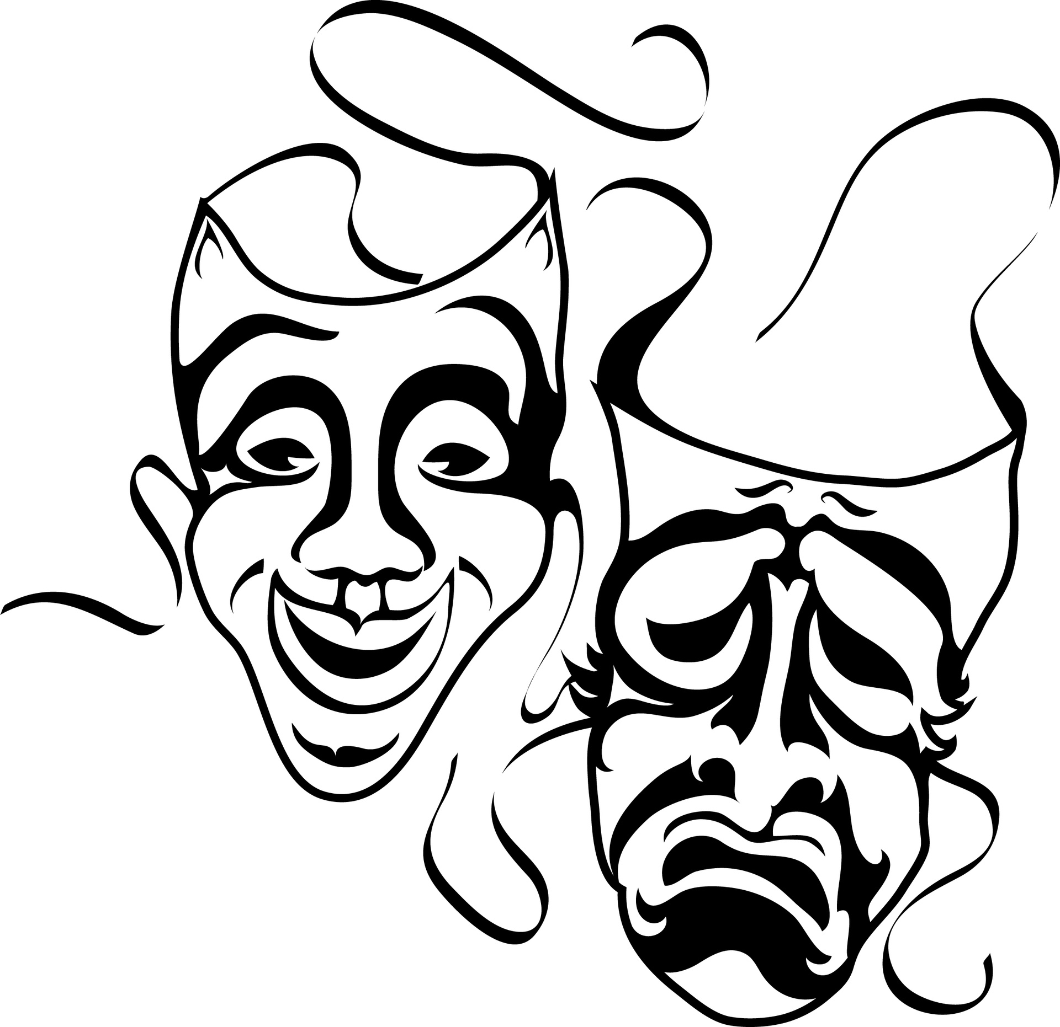
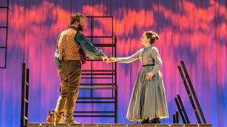
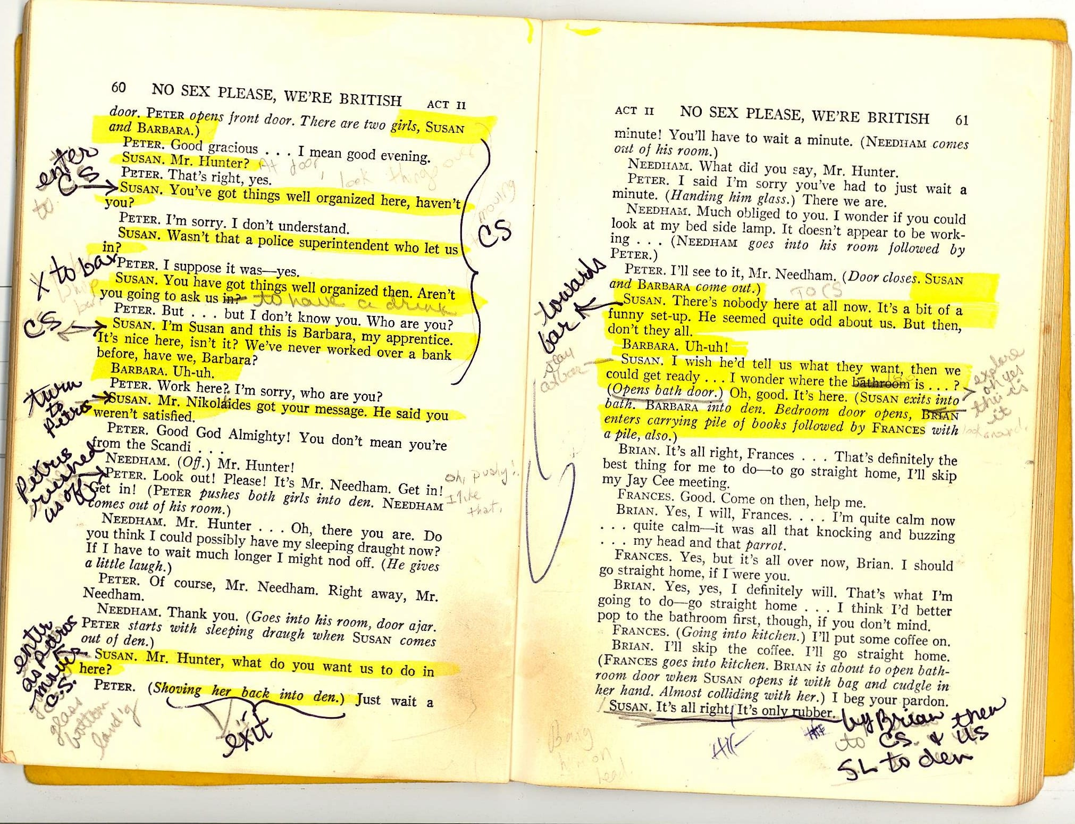
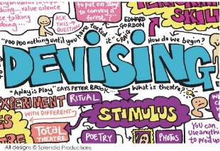
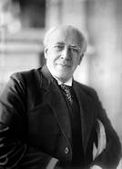
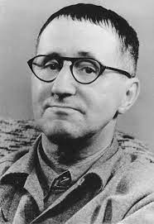
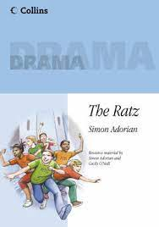
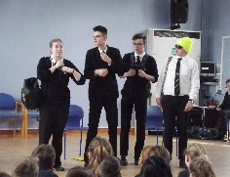
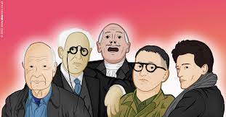
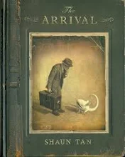
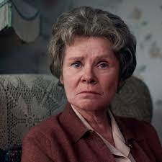
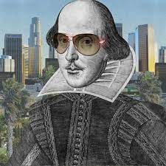
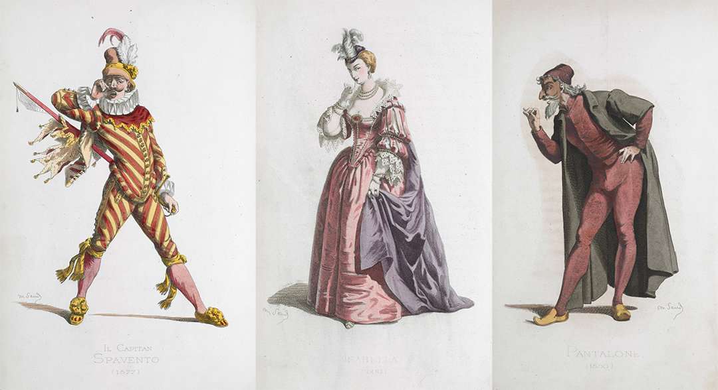
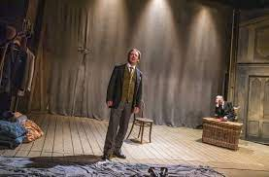
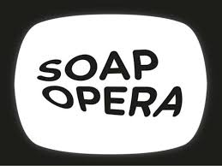
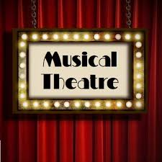
Knowledge
Subject Specific Skills
Drama Curriculum Roadmap
Question: Is it important to stay true to a playwright’s intention? – Recall C3 Interpreting Theatre. Study of set text IC & Live Theatre Response
Progression to next stage of learning:
A Level Drama & Theatre
BTEC Performing Arts
C3-Interpreting Theatre
C3 – Live Theatre
C2 Scripted
Characterisation
Vocal Skills
Physical Skills
Playwright intentions, deconstructing text, Social & Historical context
Set & Staging
Costume
Lighting
Sound
Performance Style
Question: What’s it all about? Text Exploration of set text An Inspector Calls.
C3 –An Inspector Calls
C2- Scripted- Mock
11
C1 -Devising
Drama
Question: What makes good theatre?
C1 – Devising Drama - To explore a range of stimuli & use knowledge of
performance styles, genre & form to devise a piece of theatre for Component 1
Proxemics
Staging
Set
Narration
Mime
Lighting
Sound
Costume
Question: What's in a name? C2 Exploring character, language, structure & meanings created in a live production
Characterisation
Vocal Skills
Physical Skills
10
Who’s Who
Brecht and stimulus
Text Exploration
Horror & Tension
Question: What type theatre is more powerful, naturalistic or non-naturalistic? Who’s Who - Explore a range of performance styles including Brecht, Stanislavski, Berkoff
Text exploration
Director's intentions
The Arrival
The
Ratz
Stimulus and Practitioner
9
Direct Address
Narration, Multi Role
Using a script to explore a performance
Creating a performance based upon a stimulus and under a practitioners influence
Question: Theatre should connect to people’s lives not be a piece of candy floss. Agree or Disagree?
Lady of
Letters
Status, performance style
Shakespeare
Commedia
Text exploration
Creative
Adaptation
Question? Why do situations get misinterpreted? Find out what Miss Ruddock thinks!
Question: Is Shakespeare relevant to today's society? Page To Stage – To explore plot, character, language, structure
Genre
Question: What makes a character interesting for an audience? Commedia - To develop physical comedy skills over a series of teacher led workshops, including the art of slapstick to re-tell a fairytale.
Tableau, Narration, Flashback
Question: What do audiences want?
Story Telling - To explore / experiment with HOW to tell a story on stage.
Missing
Soap
Opera
Musical Theatre
8
Story
Telling
Question: How do voice & movement combine on stage? Musical Theatre exploration.
Choral Movement
Ensemble performance
Question: Whose style is it anyway?
Creative Adaptation- To explore different script extracts / poems through dramatic techniques.
Circus
Boy!
Introduction to Drama
7
Narration, Flashback, TIR,
Mime, Tableau
Question: Why theatre? Let’s find about ‘treading the boards’!
Question: What’s more important dialogue or action?
develop confidence, acting skills and unleash imagination!
Freeze, thought track, stage, backdrop
Resilience
Kindness
Respect
Curiosity
Collaboration
Endeavour

