Slide 1
Title – Delaying Sexual Activity
Date:
In today's lesson we will:
Understand the reasons why it is beneficial to delay having sex
Consider emotional, physical and social reasons for it
Review the legal aspects of delaying sexual activity.
Today's big question is
What are different ways of showing someone how you feel about them?

Slide 2
Class discussion
“What do you think are some reasons people choose to wait before having sex?”
“What are some possible risks of having sex too early?”

Slide 3
Ground Rules...
It's important that we maintain respectful and open space for sensitive topics.
Everyone has different views and values around sex, and this lesson will explore why delaying sex can be a positive choice for many.

Slide 4
Why Delay?
EMOTIONAL READINESS
Understanding emotions: Teenagers may not yet have the maturity to handle the emotional complexity of sex. It’s important to be emotionally prepared for the potential feelings that come with it, like attachment, guilt, or anxiety. | Respect and consent: Healthy relationships are built on trust, communication, and mutual respect. It’s important to be sure that both partners are ready and that their decision is mutual.

Slide 5
Why Delay?
PHYSICAL HEALTH
Sexual Health and Risks: Discuss sexually transmitted infections (STIs) and the risk of unplanned pregnancies. Emphasize that these risks can have long-term impacts on health. | Physical Readiness: Not everyone’s body is ready for sex at the same age. Sex can bring physical consequences that might not be fully understood or prepared for in adolescence.

Slide 6
Why Delay?
SOCIAL IMPACT
Peer Pressure: Talk about how peers can sometimes influence decisions, and that it’s okay to say "no" or wait until you feel ready. | Self-Respect: Having boundaries and understanding what makes you feel comfortable is key to maintaining self-respect and having healthy relationships with others.

Slide 7
Why Delay?
LEGAL AND ETHICAL ASPECTS
The Law: In the UK, the legal age for consensual sex is 16. Before this age, any sexual activity is illegal. Discuss the importance of respecting the law and being aware of legal consequences. | Responsibility: Discuss the responsibilities involved in sexual activity, like ensuring mutual consent and considering the consequences.

Slide 8
Why Delay – pair activity
With the knowledge of 8 different reasons to delay sexual activity, what order would you put them in – in terms of the most important reason to the least important reason.
Rank them 1-8.
Be prepared to justify your choices as a pair

Slide 9
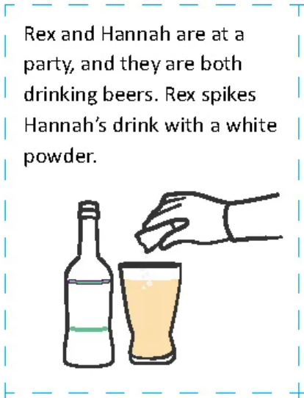
Scenarios...
Have a look at the different scenarios on page...
In pairs discuss what factors within each scenario indicates a need to delay sexual activity.
For example:
This scenario shows that Rex does not have the emotional readiness to have sex. He is not respecting Hannah or seeking consent.
He is also not considering the ethical aspects of this – not seeking consent

Slide 10
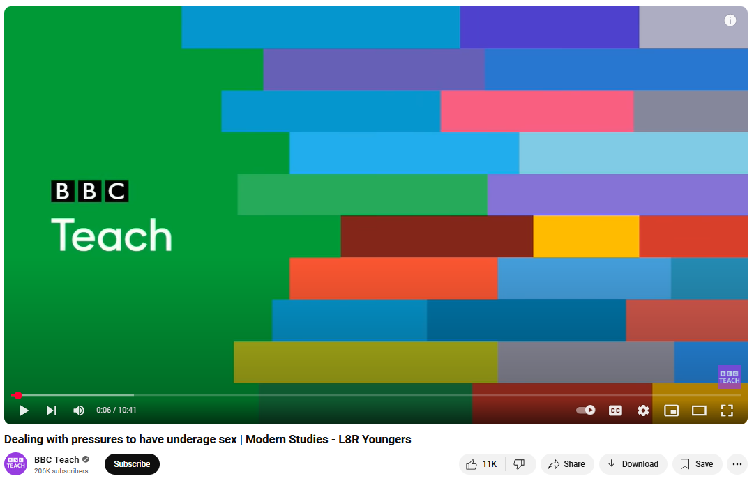
https://www.youtube.com/watch?v=Y23dAvFFHro&t=10s

Slide 11
Reflection
Key Points Recap
Delaying sex is a personal decision that helps ensure emotional and physical readiness, reduces risks, and upholds social and legal responsibilities.
Please remember to always communicate openly with trusted adults if you need advice.
Reflection Question
Describe how you would handle a situation where someone you know is thinking about having sex.
What would you say to them about the importance of waiting?

