Slide 1
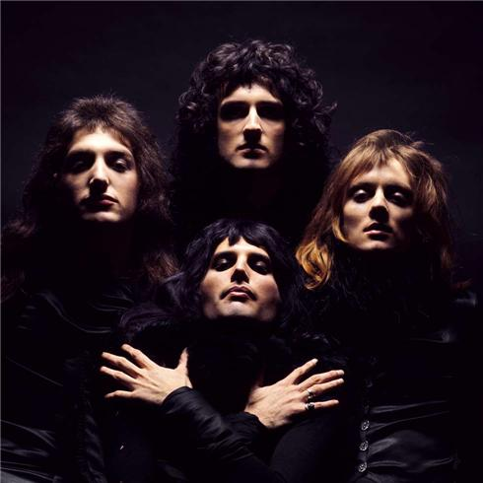
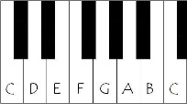
Music Curriculum Roadmap
BACH BRANDENBURG
BEETHOVEN PATHETIQUE
DEFYING GRAVITY
SOLO AND ENSEMBLE PERFORMANCE
COMPOSITION TO A BRIEF
c
Year
11
STAR WARS
KILLER QUEEN
AFRO CELT
PURCELL
SAMBA EM PRELUDIO
Year
10
SOLO AND ENSEMBLE PERFORMANCE
FREE COMPOSITION.
INTRODUCTION TO GCSE MUSIC.
Year
9
AXIS OF AWESOME
FILM MUSIC
POPULAR MUSIC
DORIAN
EDM AND MUSIC TECHNOLOGY
Year
8
AN INTRODUCTION TO MUSIC TECHNOLOGY.
BLUES
PITCH NOTATION AND KEYBOARD SKILLS.
Year
7
AFRICAN DRUMMING.
THE ELEMENTS OF MUSIC AND RHTHM NOTATION.
RHYTHM NOTATION AND PERFORMANCE SKILLS
Resilience | Kindness | Respect | Curiosity | Collaboration | Endeavour

