Slide 1
TEACHER SLIDE: Things to remember/ be aware of
Lessons on sexual images including sending nudes/sexting, media representations and pornography is likely to raise a lot of discussion. Some students may feel embarrassed or awkward when discussing this subject. Equally some students might have a lot of questions and will want to discuss the topic in great detail. There is the potential for safeguarding disclosures. To support students’ right to confidentiality, it is important to reinforce the ground rule that no personal stories should be shared in class and to signpost to confidential support. Ensure you have looked through this lesson prior to teaching and have considered any sensitivities and prior knowledge about specific students’ circumstances.
Remind students to use the question box if there is anything they wish to ask anonymously.
Throughout there is advice and suggestions within the notes section of the PPT – so make sure you have looked through.

Slide 2
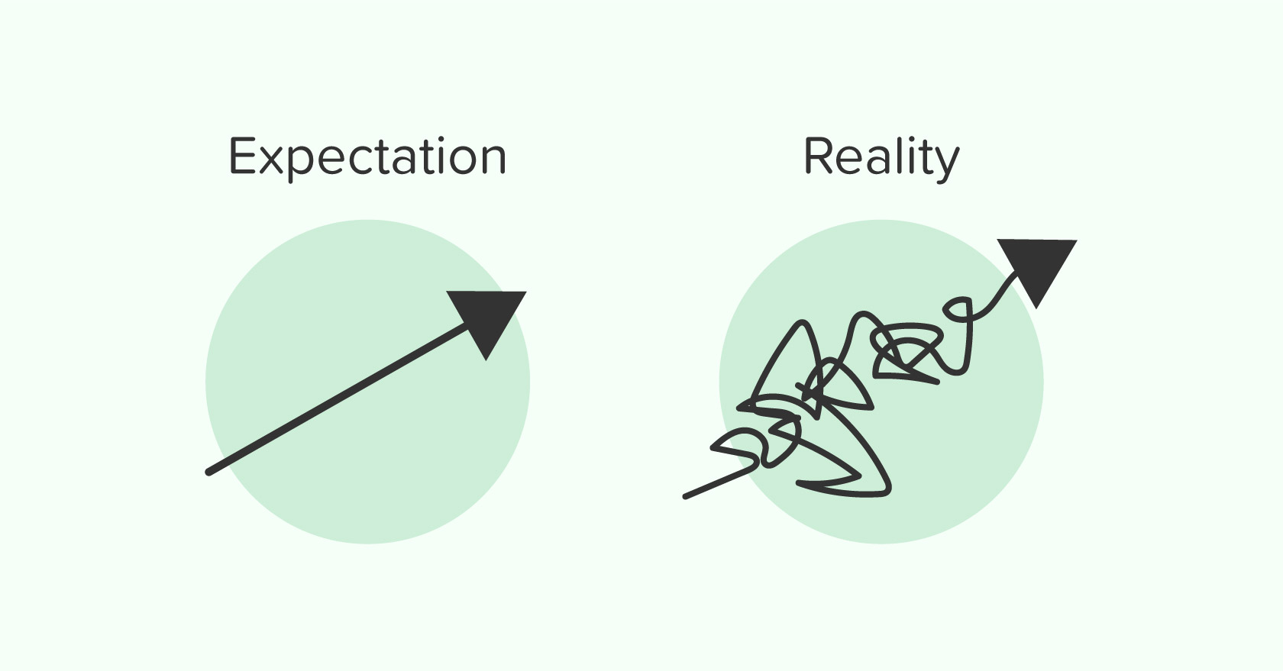
TITLE – INFLUENCES ON RELATIONSHIP EXPECTATIONS (PAGE 12)
DATE:
In today's lesson we will be able to:
Justify my views around expectations in relationships
Explain issues relating to the sharing of sexual images
Explain how the media can distort relationship expectations
TODAY'S BIG QUESTION
What are examples of unrealistic expectations?

Slide 3
How would you challenge something that was unrealistic? Would it differ depending on who was asking you to do it? - A friend - A family member - A teacher at school - Your boyfriend/ girlfriend
DISCUSSION QUESTIONS FOR TODAY
USE THE SPACE AT THE BOTTOM OF PAGE 12 TO WRITE DOWN YOUR IDEAS

Slide 4
Values – page 13
Read the statement and decide if you agree or disagree with it.
If you think it depends, write what you think it would depend on in the middle column on your sheet.
Agree
Depends on…
Disagree
Share your views with others and identify any points of disagreement.

Slide 5
Sending nudes (use post it notes or mini white boards for ideas feedback thoughts as a group)
Jasmin is 13. She met her partner, who is 15, online and they have been going out for three weeks.
She’s sent them some pictures, but they keep hinting they’d like to see more of her body.
How might Jasmine be feeling?
What might Jasmine be thinking?
Notes:
Ask the class to think about how Jasmin may be feeling and what she may be thinking. Ask them to write their ideas on post-it notes/ mini whiteboards and add them to a class mind-map.
Feedback as a class the common concerns and feelings Jasmin might have.
Students are likely to discuss some of the following:
• Jasmin is feeling pressure from her partner, and some of this may be due to her partner being older so Jasmin feels she has to show sexual maturity to ‘keep up’.
• The relationship hasn’t been going for very long, Jasmin may either feel pressure to hold on to the relationship, or she might not feel that attached to the relationship, or she might find the requests a bit annoying.
• Jasmin might be worried about whether her partner will tell other people if she does or does not send a picture, or if they’ll share the picture afterwards with other people. She might also be thinking about what other people her age do and whether it’s legal to send a picture of her body.

Slide 6
Sending nudes: advice
Work in groups to imagine you are a group of Jasmine’s friends.
What could you say to reassure Jasmine?
What could you advise Jasmine to do?
Notes:
Suggestions might include:
• Jasmin’s friends might reassure Jasmin that she doesn’t need to send pictures that make her feel uncomfortable.
• They might discuss the possibility that images could be shared and the consequences of this.
• Friends might also suggest that Jasmin could talk to a teacher or other trusted adult.

Slide 7
Sending nudes
Taylor is 15. All their friends say they’ve had sex and have shared loads of sexy photos to prove it.
Taylor feels pressure to get photos from their partner to share too.
How might Taylor be feeling?
What might Taylor be thinking?
Notes:
As before, ask students to write on post-its or mini white boards to contribute to a class mind-map on what Taylor may be thinking and feeling.
Discuss the situation as a class.
Students are likely to discuss some of the following:
• The pressure Taylor is feeling is mostly about proving sexual maturity
• A major motivation is Taylor’s desire to show a picture to friends, not an actual desire to see a picture •
If Taylor is male, this is likely to be more about proving masculinity, given some stereotypes around this kind of behaviour.

Slide 8
Sending nudes: advice
Work in groups to imagine you are a group of Taylor’s friends.
What could you say to reassure Taylor?
What could you advise Taylor to do?

Slide 9
Comparing the scenarios
Jasmin is 13. She met her partner, who is 15, online and they have been going out for three weeks.
She’s sent them some pictures, but they keep hinting they’d like to see more of her body.
Taylor is 15. All their friends say they’ve had sex and have shared loads of sexy photos to prove it.
Taylor feels pressure to get photos from their partner to share too.
Does anything strike you about the two scenarios?
Notes:
At the end of the exercise put Jasmin and Taylor’s scenarios up side by side and ask the group “Does anything strike you about this?”
At this stage, if not before, it usually becomes clear that Jasmin and Taylor could well be a couple – both likely to end up sharing photos they don’t really want, to meet a completely different set of needs.
Allow sufficient time to discuss gendered norms around relationship expectations.

Slide 10
TEACHER TO SET UP:
Display 4 sheets around the room with the following titles –
sports and leisure time,
clothing,
job roles,
behaviour and traits.
Students should draw and write any gender stereotypes or news stories on the board they are familiar with, along with an explanation of why such stereotypes or incidents are unacceptable.
For example, a person might suggest that jobs in the military should be done by men – this is outdated as women have worked successfully alongside men in combat situations for some time now, and since 2018 have been able to join in any role including those in the infantry which were previously restricted to men.
It is important to ensure that ground rules on offensive/prejudice-based remarks must be respected in this activity.

Slide 11
Gender expectation stereotypes
Using the titles around the room, draw and write any gender stereotypes or news stories you are familiar with.
Include an explanation of why such stereotypes or incidents are unacceptable.
Sports and leisure time
Clothing
Job roles
Behaviour and traits
Remember the ground rules: avoid offensive terms
Notes:
Support: Students can add pictures or articles from magazines, advertisements and toy catalogues which show examples of gender stereotypes and explain verbally why they are not a good thing.
Challenge: Ask students to annotate each of the stereotypes with an explanation of where they think these stereotypes are perpetuated and any examples of where they have seen these challenged. For example, how the news discusses different genders, how genders are represented in films, who is chosen for adverts on TV for particular jobs.

Slide 12
Helping a friend – PAGE 14
Using the worksheet, offer advice and support to a friend.
Notes:
Encourage students to consider factors such as:
• If someone is being pressured to do something they don’t want to do, they should consider whether their partner is really the right person for them. • Most relationships do not feature this kind of pressure – often there would be a discussion to help each other decide and communicate about whether they feel ready

Slide 13
Signposting support
If you would like further guidance or support:
speak to a parent/carer, tutor, head of year, school nurse/counsellor or other trusted member of staff in the school
Visit:
A Better Medway: www.abettermedway.co.uk
Brook: www.brook.org.uk/help-advice
Childline: www.childline.org.uk 0800 1111

Slide 14
REFLECTION
5 THINGS I'VE LEARNT/ UNDERSTOOD
List 5 points about sending nudes or the influence of the media (could be facts, consequences, legal issues etc.).
Can you explain the law relating to the sharing of sexual images to a partner?

Slide 15
More activities
Video resources
Watch the film Sending nudes ft. Beauty Spectrum and discuss the issues raised. You could create a class list of reasons for and against sending nude images.

