Slide 1
TEACHER INFORMATION
This lesson covers a very sensitive topic, and as such you need to be mindful of yours and student's emotions.
Ensure you create a safe space for discussion.
Try not to challenge misconceptions negatively but with curiousity and questions like 'Why do you think that?' Or 'Can you explain your perspective'
Assure students that the topic is important, and the classroom is a safe space for discussion. Let them know they can take breaks if needed and that they can speak privately with a trusted adult after the lesson.

Slide 2
TITLE – Understanding Domestic Abuse and How to Seek Help (page 21 )
DATE:
In today's lesson we will:
Understand what domestic abuse is and the different forms it can take.
Recognize the signs of domestic abuse in relationships.
Understand the impact of domestic abuse on individuals and families.
Know where to go for help and how to support others.
Explore healthy relationships and how to build them.
TODAY'S BIG QUESTION
What do you know about the term "domestic abuse?"
3 Minutes

Slide 3
What is domestic abuse?
Definition: Domestic abuse refers to behavior in a relationship where one person seeks to control or harm the other. It can happen between intimate partners, family members, or even housemates.
Are there any questions about what this is?
Any misconceptions?

Slide 4
https://www.bbc.co.uk/teach/class-clips-video/articles/zvr7d6f

Slide 5
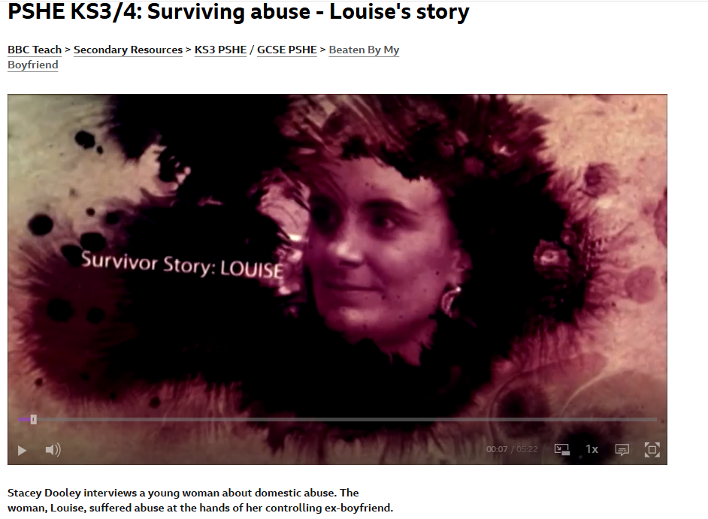
Case Study
Stacey Dooley interviews a young woman about domestic abuse. The woman, Louise, suffered abuse at the hands of her controlling ex-boyfriend.
Louise is injured during an argument in which her ex-boyfriend drives off while she is still attached to the car.
After visiting the hospital, she ends up in a refuge.
This clip is from the series Beaten By My Boyfriend.
We are going to watch a case study that shows you a survivor's story.
Please be mindful and compassionate as we don't always know what is going on in another person's life.
We are all learning from different perspectives and this topic may be difficult for some people in the room.
https://www.bbc.co.uk/teach/class-clips-video/articles/zhn4bdm

Slide 6
Reflect on what you watched
What behaviors were demonstrated in the video?
Can you list the ways the abuser controlled Louise.

Slide 7
Identifying the Signs of Domestic Abuse (page 22)
Did you think of any of the following?
Frequent injuries, especially ones with inconsistent explanations.
Withdrawal from friends and family.
Being overly controlled or manipulated.
Feeling afraid to speak freely or make decisions.
Signs of Abuse: Discuss in pairs how to recognize signs of domestic abuse in relationships
Then feedback your ideas to the group

Slide 8
Scenarios – is domestic violence occurring? What advice would you give?
The following scenarios are designed to engage students, prompt discussion, and provide insight into the dynamics of domestic abuse. They can also be used to encourage students to consider appropriate responses to supporting victims and seeking help.
Situation: Mia is in a relationship with her boyfriend, Tom. Over time, Tom begins to criticize her appearance, intelligence, and decisions. He makes her feel worthless and constantly tells her that no one else will love her. Mia feels anxious, but she doesn’t know if this is normal in relationships. She starts to feel isolated, not wanting to spend time with friends.
Discussion Points:
What signs of domestic violence can be identified in this scenario?
How might Mia feel about herself in this relationship?
What support systems could Mia reach out to if she realizes this behavior is harmful?

Slide 9
Scenarios – is domestic violence occurring? What advice would you give?
The following scenarios are designed to engage students, prompt discussion, and provide insight into the dynamics of domestic abuse. They can also be used to encourage students to consider appropriate responses to supporting victims and seeking help.
Situation: Sam and his partner, Jordan, have been together for a year. Recently, Jordan has started getting angry and sometimes pushes or hits Sam during arguments. Sam feels scared, but he is afraid of telling anyone because he worries people won’t believe him or will blame him. He doesn’t know if the situation is bad enough to ask for help.
Discussion Points:
How can physical abuse manifest in relationships?
What are the potential risks of staying in a relationship with physical abuse?
Where can Sam go to seek help and advice in this situation?

Slide 10
Important things to remember:
Domestic abuse can happen in any relationship (e.g., romantic, familial) and affects people of all ages, genders, and backgrounds.
Abuse is not just physical — it can be emotional, psychological, sexual, or financial.
Everyone has the right to feel safe in their home, school, and relationships.
Support is available — there are hotlines, counselors, and trusted adults who can help people in abusive situations.
There is no excuse for abuse — nobody deserves to be mistreated or controlled.

Slide 11
The Impact of Domestic Abuse
Emotional and Psychological Effects: can lead to anxiety, depression, low self-esteem, and post-traumatic stress disorder (PTSD).
Impact on Families and Communities: Abuse can affect not just the victim, but also children, friends, and wider communities. Children who witness domestic abuse can also be affected and are also viewed within the law as victims, even if the abuse hasn't been directed at them.
Discuss as a group: How can the cycle of abuse affect future relationships?

Slide 12
Support and Getting Help
How to Seek Help:
Key organizations and resources available for support:
National Domestic Violence Helpline (UK): 0808 2000 247
Childline: 0800 1111 (UK).
Local Authorities/Services:
Refuge’s Domestic Violence and Abuse Service Warwickshire – 0800 408 1552 (Helpline)
Visit WADA's https://www.talk2someone.org.uk/ website or call the freephone helpline on 0800 4081552

Slide 13
Reflection point
Here are some sentence starters you can use to offer support to someone:
"I'm here for you if you need to talk."
"How can I help make things easier for you?"
"Is there anything specific I can do to support you right now?"
"If you need anything, don't hesitate to reach out."
"I’m really sorry you’re going through this. Let me know how I can assist."
"You don’t have to go through this alone, I’m here for you."
"I believe in you, and I’ll stand by your side through this."
"Would it be helpful if I …?"
"I can help with that, just let me know what you need."
"You’re not alone in this, we’ll figure this out together."
"How can we support someone who may be experiencing domestic violence, and what steps can we take to create a safer and more supportive environment for those affected by it?"

