Slide 1
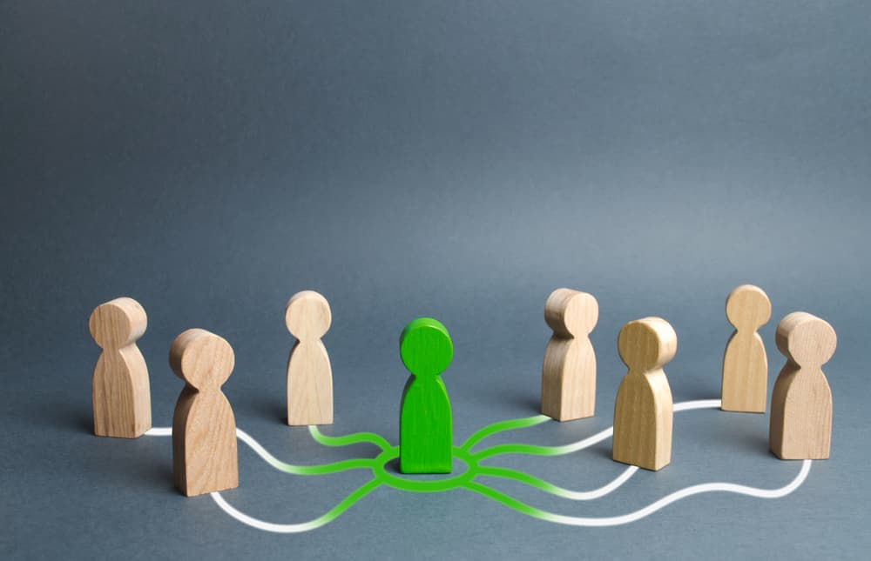
Title – Relationships & Partners (page 17)
Date:
In today's lesson we will:
Understand the concept of different types of relationships (family, friendships, romantic).
Recognize healthy and unhealthy relationship behaviors.
Identify the qualities of a respectful and supportive partner.
Today's big question is
What does a relationship mean to you?

Slide 2
Acknowledge Variety:
Please remember and respect that everyone experiences relationships differently and different people may have different feelings and reasons the topics we are discussing.
We have all had different experiences in life and we are trying to be curious and compassionate about what makes a healthy relationship

Slide 3
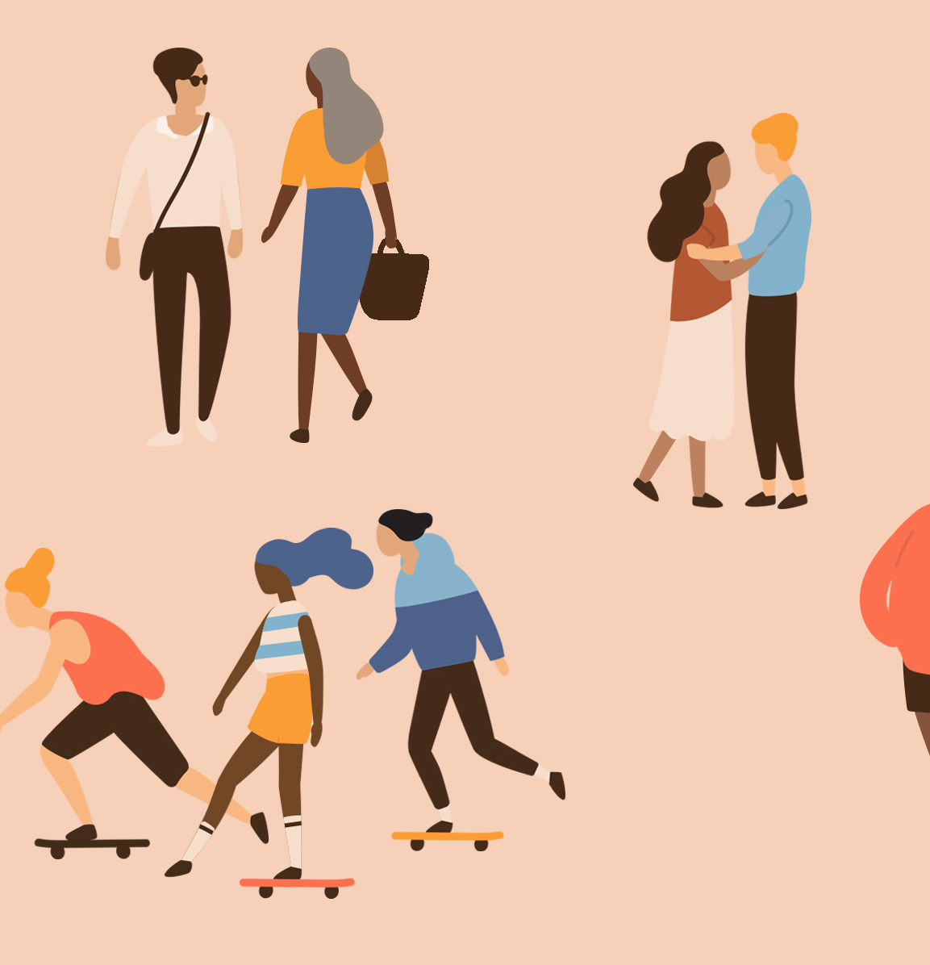
Class discussion Split the class into groups and assign them a question to discuss – then feedback to the class (bottom pf page 17)
What kinds of relationships can you think of?

Slide 4
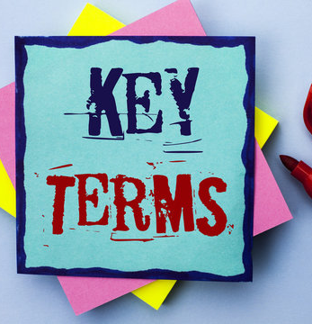
Key Terms to be aware of this lesson
Relationship: A connection or bond between people, which could be familial, platonic, romantic, etc.
Partner: Someone with whom you have a close, personal connection, especially in a romantic relationship.
Consent: The clear and voluntary agreement to engage in something (like a relationship or a specific action within it). Sexual Consent is an agreement between participants to engage in sexual activity. Consent should be clearly and freely communicated.

Slide 5
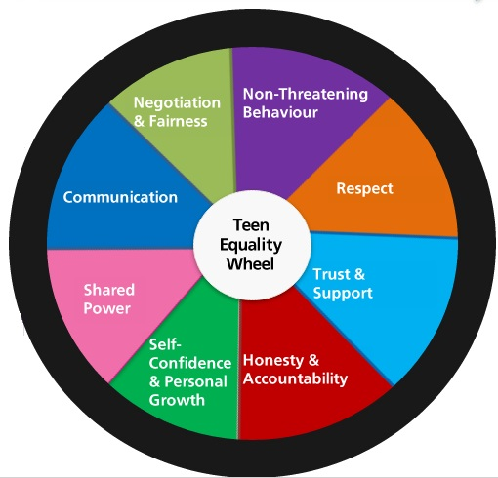
Group discussion: Different Types of Relationships: Bottom of page 18
Some ideas... can you think of others?
Group the class into small groups. Assign each group a type of relationship:
Family relationships
Friendships
Romantic relationships
Have each group come up with a few examples and qualities of each type of relationship (e.g., trust, support, boundaries).
Class feedback
Add ideas to the board
Share key qualities
Are there any that crop up in all categories?
Notes:
Please consider your groupings – think about ensuring diversity within the groups, this is to help allow different opinions within the groups and different levels of ability/ understanding

Slide 6
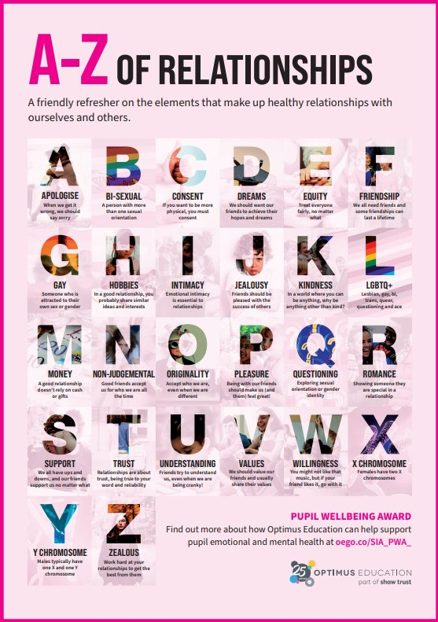
Qualities of a Healthy Relationship
In the space you have been given on page 19 can you create an A-Z poster that indicates attributes that are important for healthy relationships.
What makes a relationship healthy?
What should you expect from a respectful partner?
What qualities make a good friend, partner, or family member?

Slide 7
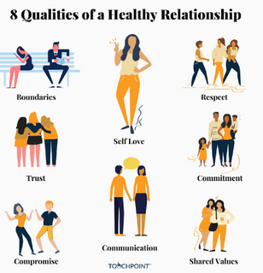
The characteristics of positive and healthy friendships (in all contexts, including online) including:
Trust,
Respect,
Honesty,
Kindness,
Generosity,
Boundaries,
Privacy,
Consent,
The management of conflict, reconciliation and ending relationships.
This includes different (non-sexual) types of relationship

Slide 8
Scenario task
Scenario 1: Respecting Boundaries
Context: Sarah and James have been friends for a while and often hang out together. James has started sending Sarah texts late at night asking if she wants to hang out, even when she says she’s busy. Sarah starts feeling uncomfortable, as she values her personal time and space.
Discussion Points:
How can Sarah express her feelings to James in a respectful way?
Why is it important for both people to respect each other's boundaries in a friendship or any relationship?
What are the signs that someone’s personal boundaries are being crossed, and how can these be communicated effectively?
In pairs discuss the different scenarios (it doesn't matter which order) on pages 20-21
Your teacher will circulate the room to see what you are discussing
But before you go off on your own to discuss, lets have a look at the first one together

Slide 9
Reflection Activity
Use the space provided on page 22
To do one of the following reflection activities:
Write a short reflection on what you think is important in a healthy relationship and why. You can consider family relationships, friendships, and romantic relationships.
or
Create a picture/ poster that shows the characteristics of a healthy relationship. They can use pictures, quotes, or symbols.

