Slide 1
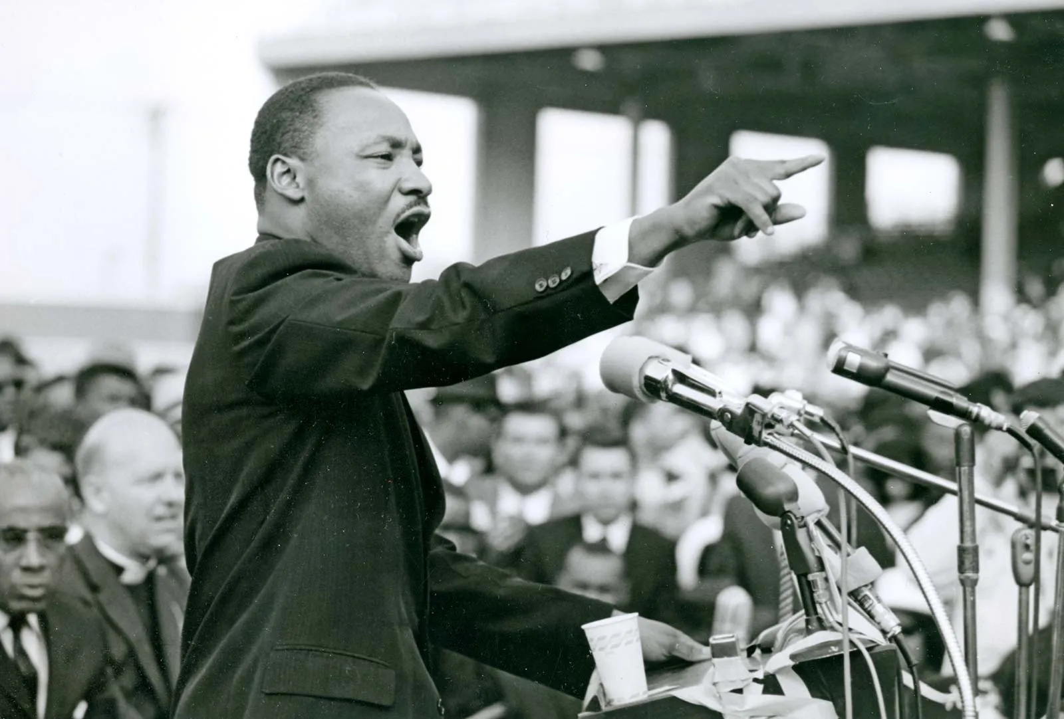
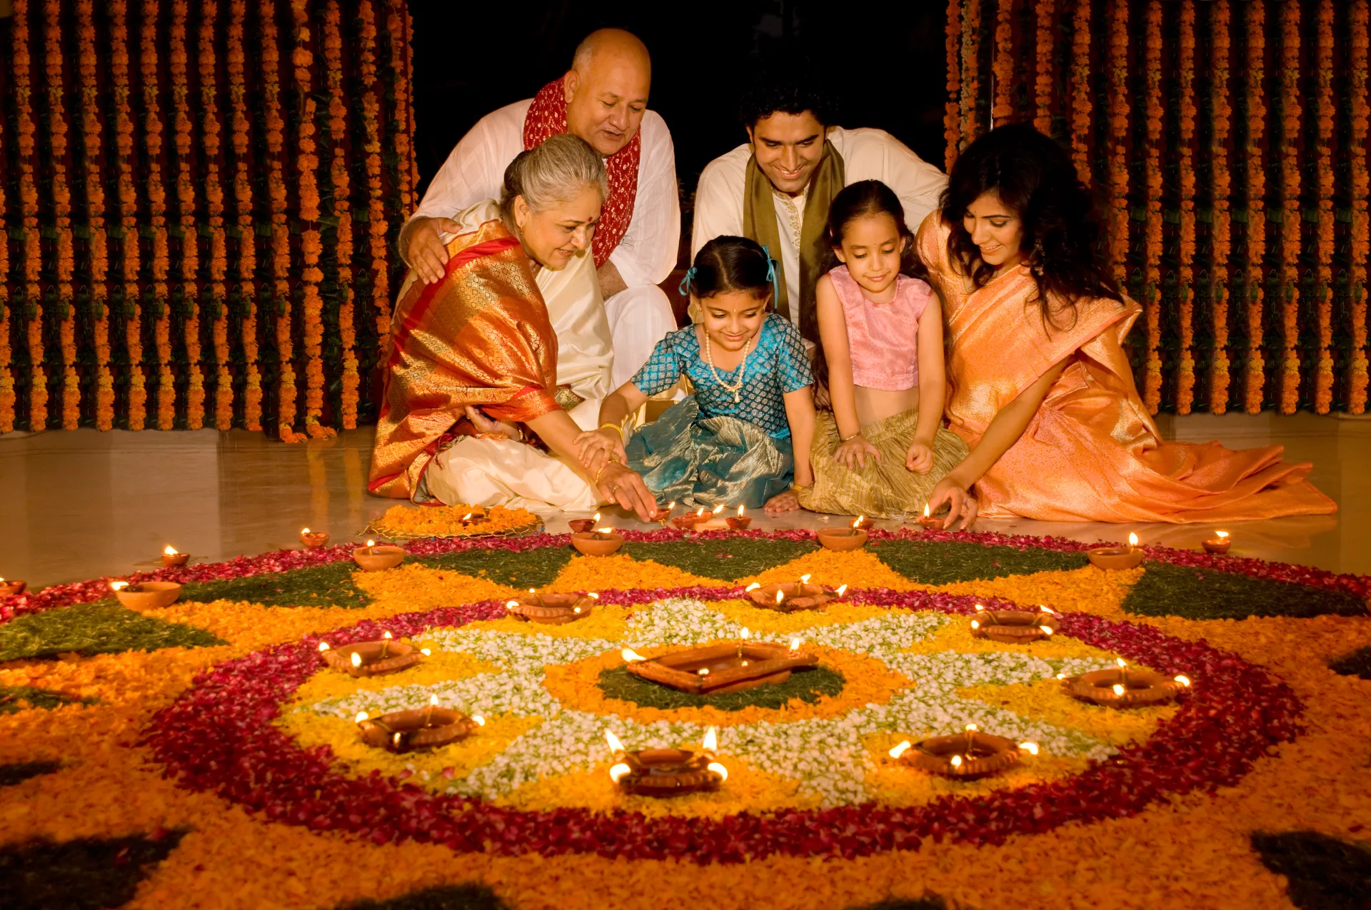
RE Curriculum Roadmap
Year
11
External Exam
GCSE Summer Term Year 10:
Paper 2 Thematic Studies
Theme A – Relationships and Families
Theme B: Religion and Life
GCSE Autumn Term Year 11:
Paper 2 Thematic Studies
Theme D – Religion, Peace and Conflict
Theme E: Crime and Punishment
Year 11 Spring Term
Revision
Islam
GCSE Spring Term Year 10:
AQA GCSE Religious Studies
The beliefs, teachings and practices of Islam
GCSE Autumn Term Year 10:
AQA GCSE Religious Studies
The beliefs, teachings and practices of Islam
GCSE Autumn Term Year 10:
AQA GCSE Religious Studies
The beliefs, teachings and practices of Christianity
Christianity
Year
10
GCSE Summer Term Year 9
AQA GCSE Religious Studies
The beliefs, teachings and practices of Christianity.
Year 9 Spring term – Sikhism in the Community
An exploration of the role of faith at a grass roots / community level with a particular focus on Sikhism
Autumn Term Year 9
Why can belief be so divisive?
An exploration of War, Peace and Conflict with links to modern case studies
Year 9 Autumn Term 2
Can religion be a force of good? –
An exploration of how faith and belief can be a force of good and drive change.
Year
9
Summer Term Year 8
Is everyone capable of being good?
Ethical, moral and religious debates
Year 9 Unit : Ethics, Peace and Conflict
Spring Term Year 8
Matters of life and death - Explore religious positions on life, death, eternity but also draw comparisons with ethical debates, humanism
Autumn Term 1- Year 8
Belonging and Believing
Thematic comparison of key faiths like Sikhism, Islam and Judaism and rites of passages that serve to give a sense of belonging
Summer Term: Year 7
How have individuals and belief shaped how we understand our universe?
Key creation stories, the influence of Science and key individuals like George Lemaitres, Charles Darwin
Autumn 2 – Year 8
How did faith migrate?
Explore the historical origins of key faiths and the events, individuals and processes that allowed ideas and beliefs to migrate and take root worldwide
Year
8
Unit: Summer Term - Origins of the Universe
Autumn Term Year 7 : What is belief?
What is a worldview and what factors that can shape our own
What is belief / what is religion and how has evolved over time
Spring Term Year 7
CSI Jesus
Exploration of the life and death of Jesus
Investigation of interpretations / how beliefs / events have been expressed through Art and text
Year
7
Unit: Autumn Term 1 - What is Belief?
Unit: Spring Term - Christianity
Resilience | Kindness | Respect | Curiosity | Collaboration | Endeavour

