Slide 1
SEND & Inclusion at RFSS
State of the Nation: September 2024

Slide 2
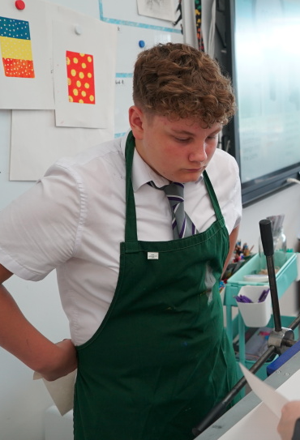
The ‘Why’:
'The heart of any successful school is its ability to create an inclusive and accommodating learning environment for students. Such schools are built around the idea that every child deserves an education tailored to their skills and needs. This especially means that students with SEND can reach their full potential and become active, engaged members of their communities.' (Campbell, 2022)

Slide 3
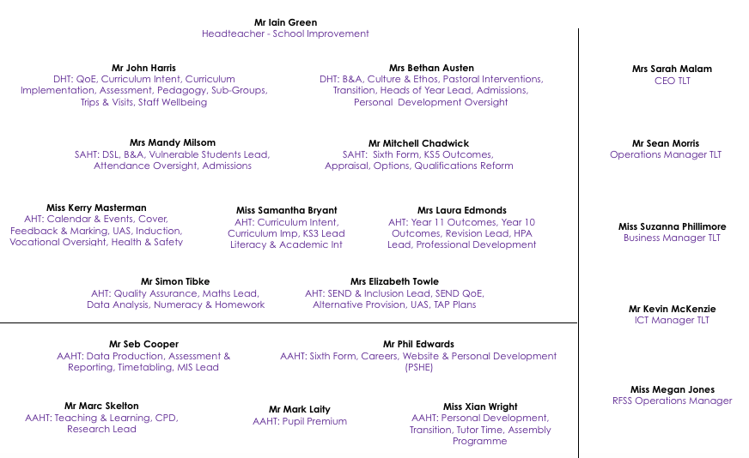
RFSS SLT 2024-25:
Kindness Curiosity Collaboration Respect Resilience Endeavour

Slide 4
Our School Priorities 2024-25:
Develop increased levels of aspiration and belonging (Key Stage 3)
Create more links
with home through
effective home
learning
strategies
Raise standards & expectations in all that we do (including Tutor Time) to best impact on outcomes
Align SEND provision
with other areas of the
school
Kindness Curiosity Collaboration Respect Resilience Endeavour

Slide 5
SEND Leadership 2024-25:
Lizi Towle: AHT – SEND & Inclusion
David Iles: SENDCo
Elsa Elliott: SRP Manager
Freya Davies: Assistant SENDCo
Maria Lasala: Key Stage 5 SEND Link Coordinator
Gayle Markham: Inclusion Room Leader

Slide 6
Key Points:
We have replaced a Trust role with an in-school role in order to ensure maximum capacity for RFSS.
We have promoted from within – both David and Freya have been working behind the scenes for the past half-term in preparation for September onwards.
Elsa will lead on the growth of the SRP, as a Lead Practitioner.
We have appointed six new LSA’s for this year.
The SEND & Inclusion team costs upwards of £600,000.

Slide 7
Key Statistics:
685 applications for Year 7 in total
222 Year 7 first-choice applications
338 Sixth Form applications for Year 12
120 - Year 12 intake
89% of our current parents and carers would recommend the school.
89% of our current parents and carers feel their child is happy and safe here.
90% of our current parents and carers feel we have an excellent extra-curricular offer.
83% of parents and carers feel their child does well at our school.
90% of parents and carers feel that the school offers a good range of subjects.

Slide 8
Key Statistics:
61% of our current parents and carers feel SEND provision is effective.

Slide 9
What You Raised:
Communication
Vacuum in terms of Leadership
Inconsistent updates from Key Adult
Classroom Support
SRP
Relationships
Kindness Curiosity Collaboration Respect Resilience Endeavour

Slide 10
The National Picture:
Over 1.5 million pupils in England are identified as having SEND (an increase of 87,000).
Overall SEND percentage is up from 16.6% to 17.3%.
EHCPs up from 4% to 4.3%.
SEND Support up from 12.6% to 13%.
Autism continues to be the primary need for the majority of children with an EHCP.
Speech, Language and Communication Needs remains the most common type of need for SEND support. This is followed by Social, Emotional and Mental Health needs.
The data suggests that SEND is most prevalent at age 10, and continues to be more prevalent in boys than girls (although this gap is decreasing).
Kindness Curiosity Collaboration Respect Resilience Endeavour

Slide 11
Key Facts:
The proportion of students with SEND at RFSS is much higher than the national average.
Year 7 and Year 8 have more SEND needs than the rest of the school combined, and Year 7 will be 4x the National Average – 15% EHCP.
We are the most popular Comprehensive school choice in Rugby.
We are the most popular choice for SEND parents and carers in all of Warwickshire.
We have the lowest numbers of suspensions and PEX in the Rugby region.

Slide 12
Our Vision:
‘We intend to provide a broad, inclusive and ambitious curriculum that empowers our students to make both academic and personal progress. As a school with a diverse demographic, our aim is to ensure that all students achieve an excellent standard of education that not only prepares them for GCSE and A Level examinations, but ensures they are ‘set for life’ beyond the gates of Rugby Free Secondary School.’
Academic progress seen in books through depth of work.
Celebrate achievements of SEND students more frequently.
Ensure SEND students receive more - Careers, Unit Award Scheme.
Continue to be the inclusive school that makes us so special - reasonable adjustments and relationships.

Slide 13
A Return to Research:
In short, the EEF recommends five key pillars for effective SEND provision in mainstream schools:
Create a positive and supportive environment for all pupils, without exception
Build an ongoing, holistic understanding of your pupils and their needs
Ensure all pupils have access to high quality teaching
Complement high quality teaching with carefully selected small-group and one-to-one interventions
Work effectively with teaching assistants

Slide 14
Area 1: Communication
SEND Newsletters that celebrates achievement.
The Day Ahead and The Week Ahead for SEND & Inclusion team.
Daily sharing of rotas and notices, including whole-school events and training.
Pastoral and SEND Crossover meetings - once per half-term.
Weekly Check In time given to LSAs and structure given for weekly check ins.
Leaders who will communicate in line with school timeframes.

Slide 15
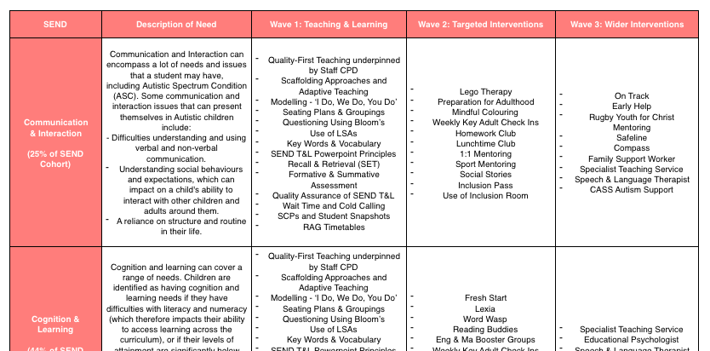
Area 2: Wave 2 Interventions
Regularly timetabled interventions - Alternative Provision visits
Tracked and monitored for impact - SEMH Mentors utilised
Tied in with Pastoral interventions
Progress reported to parents and carers

Slide 16
Area 3: Quality of Education
Programme of Quality Assurance linked to SEND students in mainstream lessons.
Adapting the curriculum on a lesson-by-lesson and termly basis.
SEND Teaching and Learning principles evident in lessons.
Student Snapshots utilised so that students have the correct levels of support.
Frequent book looks and student voice opportunities for SEND students.

Slide 17
Area 4: Staff CPD
A programme of CPD that supports staff in being the best practitioners they can be.
Links to home reading so that staff can also read about key strategies.
Bespoke CPD for staff in the SRP.
Enable staff to progress on to their next chosen pathway.
Staff sharing ideas and good practice.
A culture of staff development re-established.

Slide 18
Area 5: Staff Provision
Key staff delivering key interventions.
Classroom support given to teachers through LSA deployment.
Staff expectations to be working in classrooms or in interventions.
Staff delivering Literacy and Numeracy catch-up, where appropriate.

Slide 19
Area 6: Bringing Lunchtimes Back!

Slide 20
Offering Support:
Session | Date | Parental Session | RFSS Staffing
1 | Wednesday 4th September 2024 | SEND Coffee Afternoon and Meet the Team Event (4.30pm - 5.30pm) | SEND & Inclusion, Iain Green
2 | Tuesday 24th September 2024 | Teaching, Learning & Assessment | John Harris, Seb Cooper
3 | Tuesday 22nd October 2024 | Supporting Home Learning | Simon Tibke, Mark Laity
4 | Tuesday 12th November 2024 | Communications and Interventions | Elsa Elliott, David Iles
5 | Tuesday 10th December 2024 | Supporting Reading and Literacy | Sami Bryant

Slide 21
Summary Slide:
Our mission is to ensure that SEND is at the heart of the school – we have already started better this year with the bespoke return to school, and tonight.
We are still the market leader in Warwickshire for SEND, as confirmed by the local authority.
We look forward to working with you, our door is always open, talk to us first before you post on social media;
etowle@rugbyfreesecondary.co.uk
Our inclusion team is strong, and genuinely cares. Please come and support the calendared events.
Kindness Curiosity Collaboration Respect Resilience Endeavour

Slide 22
The Final Thought:
'Irrespective of how good you are, or how good you think you are, nothing is achieved without each other. It is team before self, every single time.' (Tait, 2019)

