Slide 1
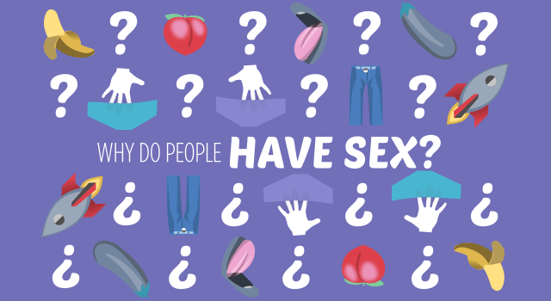
Title – Why have sex? (page 14)
Date:
In today's lesson we will:
Understand the different reasons people may choose to have sex.
Explore the emotional, physical, and social aspects of sex.
Emphasize the importance of respect, consent, and healthy relationships.
Recognize the responsibilities and risks associated with sex.
Today's big question is
Why do people have sex?

Slide 2
Acknowledge Variety:
Please remember and respect that everyone experiences relationships differently and different people may have different feelings and reasons for wanting to engage in sex.

Slide 3
Class discussion Split the class into groups and assign them a question to discuss – then feedback to the class (space at the bottom of page 14)
"What does it mean to be in a relationship?"
"What are the different types of relationships people can have?"
"What do you think is important in a relationship?"

Slide 4
Let's clarify a few things first:
Clarify Terms:
Sexual health - Sexual health is about well-being, not merely the absence of disease. Sexual health involves respect, safety and freedom from discrimination and violence.
Relationships - A relationship is the way two or more people are connected, or the way they behave toward each other: A relationship is also a close romantic friendship between two people
Consent - Consent is an agreement between participants to engage in sexual activity. Consent should be clearly and freely communicated.
Intimacy - a close, familiar, and usually affectionate or loving personal relationship with another person or group
Emotional intimacy - Emotional intimacy is the closeness and connection between two people who feel safe and secure with one another.
Physical intimacy - Physical intimacy is about touch and closeness between bodies. In a romantic relationship, it might include holding hands, cuddling, kissing, and sex. Your relationship doesn't have to be sexual or romantic to have physical intimacy. A warm, tight hug is an example of physical intimacy with a friend.

Slide 5
Group Activity: "Why Do People Have Sex?"
Instructions: Divide students into small groups and ask them to list reasons people might choose to have sex (for example – love)
Discussion: Gather answers and create a collective list on the board. Encourage students to be reflective and respectful of all opinions.
Notes:
Possible Reasons:
Emotional connection or love
Physical attraction
Peer pressure or societal expectations
Wanting to start a family (although this is more common in adulthood)
Curiosity or a desire to explore feelings of intimacy
Feeling of maturity or becoming an adult
To express feelings of closeness and affection

Slide 6
Social Aspect:
In small groups consider how societal expectations or peer pressure can influence decisions about sex.
(top of page 15)

Slide 7
Responsibilities and Risks Bottom of page 15
Discuss the risks, give each group a topic:
Unintended pregnancy
Sexually transmitted infections (STIs)
Emotional consequences (guilt, regret)
Impact on future relationships (assumptions about sexual activity in future relationships)
It's now time to talk about the responsibilities that come with sex, including respecting your partner’s feelings, communication, and considering the potential outcomes (emotional and physical).
Divide the class into small groups 4/5 people.
Each group needs a topic to discuss and then feedback their ideas to the rest of the class

Slide 8
Scenarios to discuss Choose 1 of the below scenarios to discuss in pairs
Peer Pressure
Insecurity or wanting to be accepted
Peer pressure can be strong, but it’s important to remember that everyone’s experiences and choices are different.
Sex should always be a choice made by an individual, not because of external pressure.
It’s okay to say no, and saying no to sex doesn’t make anyone less valuable or less of a person.
Description:
A teenager might feel pressured by friends or classmates who say, “everyone is doing it,” or “you’re not cool if you haven’t,” and feels they need to have sex to fit in.
Discuss – how can you challenge this? How could you reassure someone who thinks like this?
Description:
A person might engage in sex because they feel insecure and believe that it will make them feel more accepted by a partner or peer group.
Discuss – how can you challenge this? How could you reassure someone who thinks this?
It’s important to understand that self-worth doesn’t come from sexual activity or others Healthy relationships are built on trust, communication, and respect, not on the desire to fit in or prove something to others.
Taking time to understand one's feelings, body, and boundaries is essential before considering any sexual experience.

Slide 9
Reflection point
How does the knowledge you have learnt and reflected on impact your own thoughts about relationships and sex? - page 16
I believe that…
In my opinion,
From my point of view,
I think that…
It seems to me that…
I feel that…
Personally, I think…
I would argue that…
To me, it looks like…
In my view,
I strongly believe that…

