Slide 1
THE TOPICS YOU WILL COVER ARE:
Consent
FGM
Delaying sexual activity
Relationships and partners
STI's
USING THE SPACE YOU HAVE BEEN GIVEN ON PAGE 4. CAN YOU ADD AS MUCH KNOWLEDGE AS YOU HAVE ON THE TOPICS YOU WILL BE COVERING THIS HALF TERM.
WE WILL THEN ADD MORE AT THE END, TO SEE WHAT YOU KNOW NOW VS IN 5 WEEKS TIME.

Slide 2
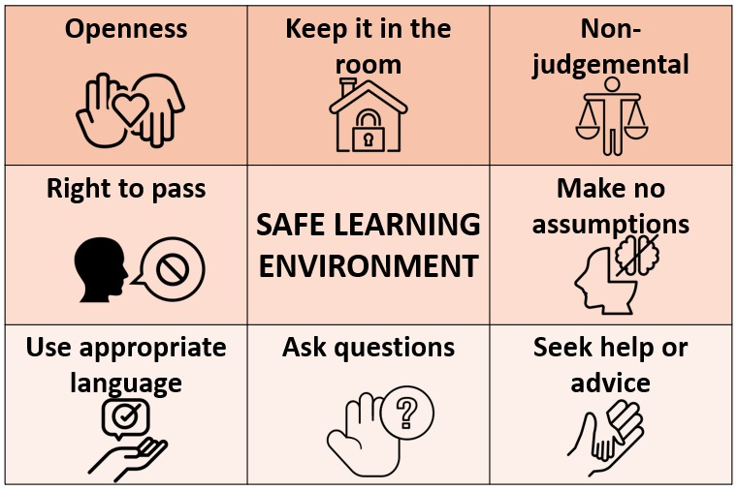
Are there any others you would like to add??
Notes:
Add rules that you would like to stick to for this block of work

Slide 3
Title – Sexual consent and the law
Date:
In today's lesson we will:
Understand the importance of consent
Be able to explain what consent is and what it is not
Understand what we need to ask consent for
Today's big question is
Why do we need to know about consent?

Slide 5
In today’s session
The why...
The what
The how

Slide 7
AT THE BOTTOM OF PAGE 5, USE THE SPACE AROUND THE WORD CONSENT, TO ADD AS MANY DIFFERENT TERMS/ WORDS THAT YOU CAN THINK OF LINK TO CONSENT

Slide 8
Treating someone with respect means: • showing regard for their abilities and worth • valuing their feelings and their views, even if you don't necessarily agree with them • accepting them on an equal basis and giving them the same consideration you would expect for yourself. Respect begins with oneself.
RESPECT
Discussion
CONSENT
BODY AUTONOMY
Body autonomy is based on the principle that everyone, regardless of their gender, sexuality and body, should be able to make informed decisions about their body, health and wellbeing.
WHY IS IT SO IMPORTANT?
What are these terms?
CHOICE
To make a choice about whether or not to take part in the sexual activity at the time in question. Choice links to if the person has the mental capacity and whether they are in a position to make that choice freely, and they are not constrained in any way.
PAGE 6

Slide 10
What actually is consent?
Consent occurs when one person voluntarily agrees to the proposal or desires of another. It is a term of common speech, with specific definitions as used in such fields as the law, medicine, research, and sexual relationships.
https://www.youtube.com/watch?v=LO3i1EJE6DI&t=1s

Slide 11
PAGE 6
Everyday examples
Everyday examples
Posting a picture of someone on a social media platform or within a group chat
Looking through someone’s pictures without asking them first
Taking someone’s picture

Slide 12
PAGE 6
Everyday examples
in school
Sending home a letter for a trip asking parents/ carers if you can go
Asking to go to the toilet in a lesson
Manual guidance within a practical subject

Slide 13
PAGE 6
Everyday examples
with friends
Giving someone a hug
Going through a person’s belongings
Holding someone’s hand

Slide 14
Thank you
www.reallygreatsite.com

Slide 15
PAGE 6
Sexual examples
Asking someone if they want to have sex
Asking if someone wants to get naked or to see you naked
Finding out if the person wants to become intimate

Slide 16
PAGE 6
https://www.youtube.com/watch?v=QTSDIilyA2I

Slide 17
Thank you
www.reallygreatsite.com

Slide 18
The Law and where you stand
Discuss with a partner what the law is in the UK with regards to consent – what is the age you are able to give consent for sexual activity?

Slide 19
The Law and where you stand

Slide 20
The Law and where you stand

Slide 21
The Law and where you stand

Slide 22
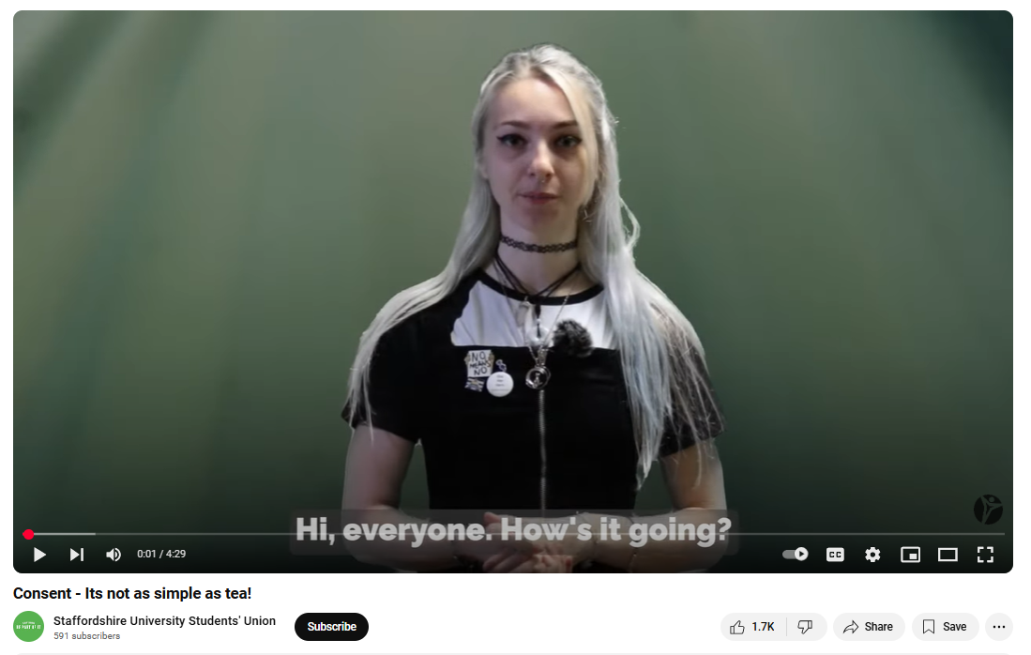
https://www.youtube.com/watch?v=NLKWEUhOHss

Slide 24
REFLECTION ACTIVITY
WHY DO YOU THINK IT IS IMPORTANT FOR EVERYONE TO LEARN ABOUT CONSENT IN SCHOOL?
Sentence starters: ​
"I believe it's important because..."​
"One of the key reasons it's important is..."​
"In my opinion, it's crucial because..."​
"It matters because..."​
​
Justification sentence starters:​
It can be argued that...​
The primary reason for this is...​
This is supported by the fact that...​
One key factor to consider is...​
A clear justification for this is...​
This decision is based on...​
Given that...​
Evidence suggests that...​
From my perspective, it is clear that...

Slide 25
QUESTION BOXES
Introduce the question box

