Slide 1


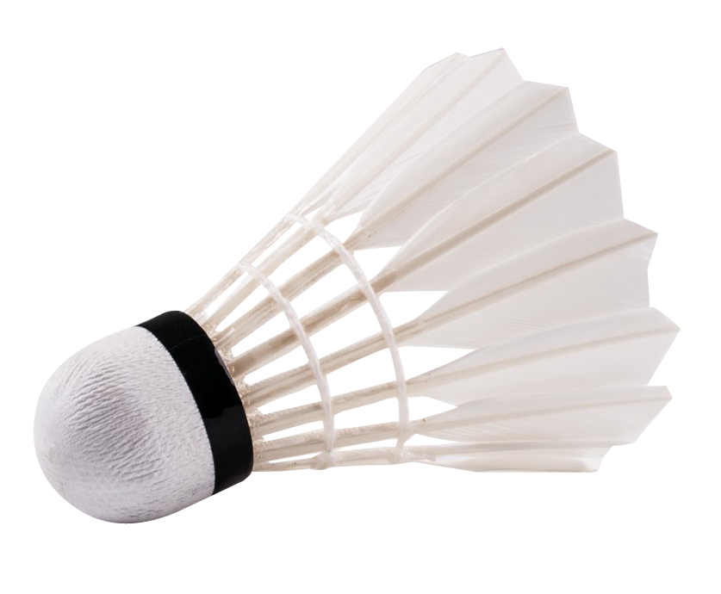
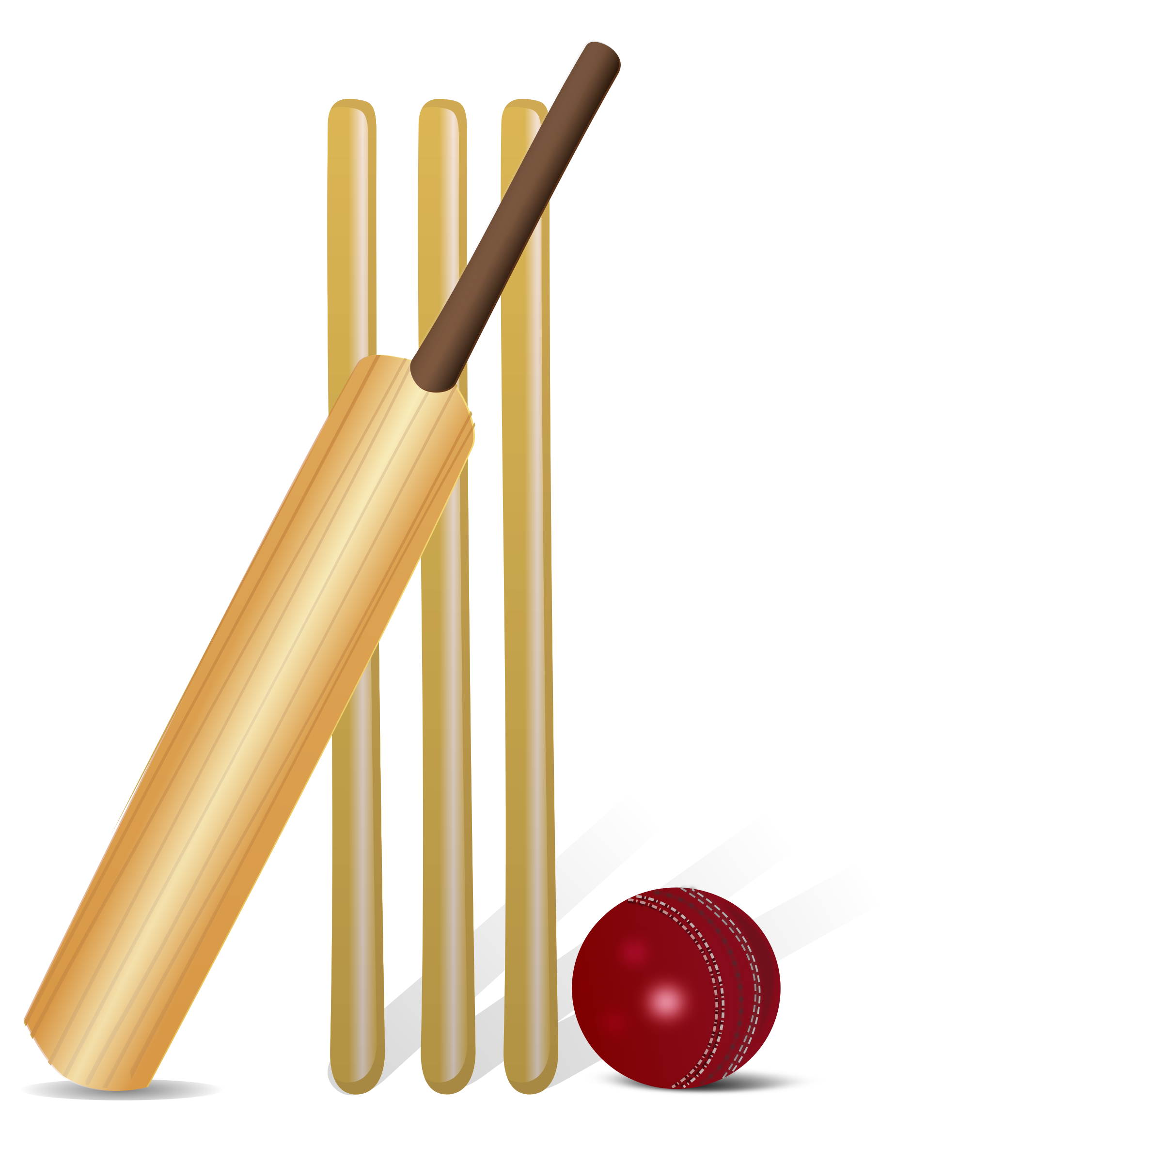















Core PE Curriculum Roadmap- Boys
Hockey
Year
11
Multi
Cricket
Invasion game
Net/wall Game
Invasion Game
Striking an Fielding
Basketball
Athletics
Softball
FItness
Table Tennis
Badminton
Year
10
Athletics
Multi
Handball
Rugby
Football
Cricket
Softball
Hockey
Leadership focus KS4: Lead a drill
Fitness
Table Tennis
Multi
Softball
Year
9
Handball
Fitness
Athletics
Cricket
Football
Rugby
Badminton
Table Tennis
Leadership focus KS3: Lead a warm up
Handball
Year
8
Gymnastics
Badminton
Softball
Athletics
Rugby
Football
Cricket
ASSESSMENT AFTER EACH SPORT [4 weeks]
Year
7
Football
Rugby
Handball
Fundamental movement skills/baseline
Badminton
Hockey
Gymnastics
Table Tennis
Resilience | Kindness | Respect | Curiosity | Collaboration | Endeavour

Slide 2

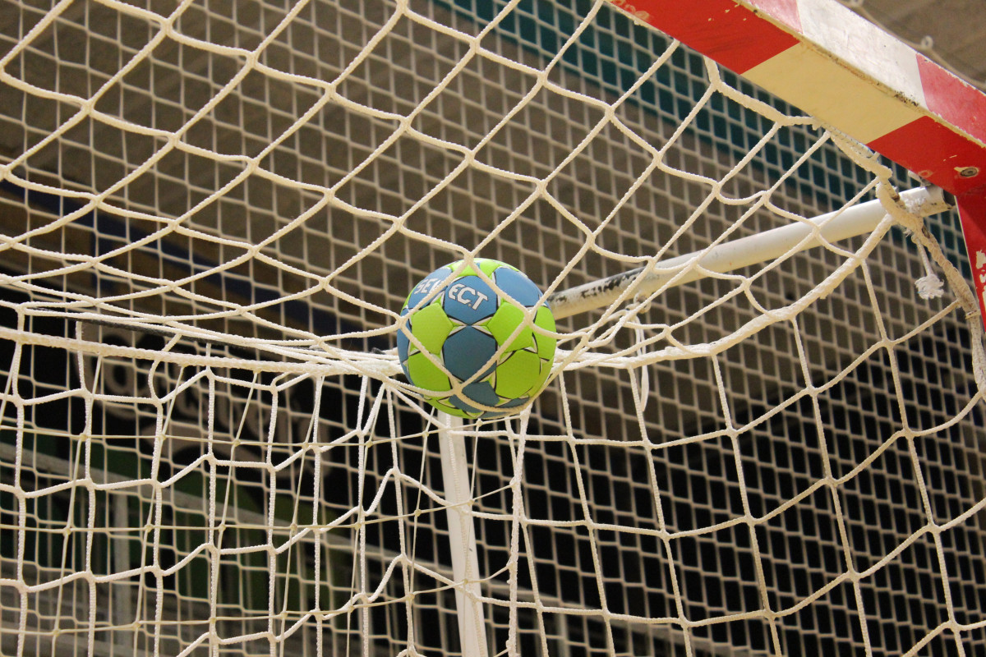
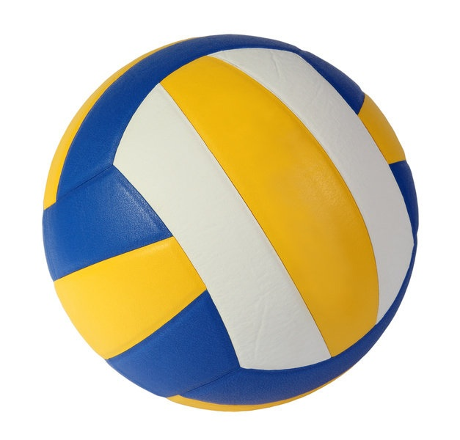
Core PE Curriculum Roadmap- Girls
Fitness
Softball
Year
11
Striking and Fielding
Athletics
Tennis
Invasion game
Net/wall Game
Invasion Game
Trampolining
Table Tennis
Football
Year
10
Handball
Badminton
Rugby
Netball
Softball
Athletics
Rounders
Fitness
Trampolining
Leadership focus KS4: Lead a drill
Table Tennis
Football
Football
Rounders
Athletics
Softball
Year
9
Handball
Fitness
Netball
BAdminton
Rugby
Trampolining
Table Tennis
Year
8
Softball
Handball
Badminton
Rounders
Rugby
Netball
Athletics
ASSESSMENT AFTER EACH SPORT [4 weeks]
Leadership focus KS3: Lead a warm up
Gymnastics
Year
7
Badminton
Netball
Rugby
Hockey
Basketball
Table Tennis
Football
Fundamental movement skills / baseline
Resilience | Kindness | Respect | Curiosity | Collaboration | Endeavour

Slide 3



Core PE Curriculum Roadmap- Mixed
Cricket
Rounders
Year
11
Striking and Fielding
Tag Rugby
Athletics
Invasion game
Net/wall Game
Invasion Game
Hockey
Trampolining
Year
10
Softball
Rounders
Fitness
Handball
Athletics
Basketball
Rugby/Tag
Leadership focus KS4: Lead a drill
Multi Sports
Handball
Cricket
Athletics
Rounders
Year
9
Hockey
Hockey
Table Tennis
Trampolining
Table Tennis
Football
Leadership focus KS3: Lead a warm up
Multi Sports
Football
Year
8
Trampolining
Athletics
Cricket
Basketball
Netball
Team building
Rounders
ASSESSMENT AFTER EACH SPORT [4 weeks]
Hockey
Year
7
Multi Sports
Netball
Table Tennis
Fundamental movement skills/baseline
Football
Hockey
Gymnastics
Resilience | Kindness | Respect | Curiosity | Collaboration | Endeavour

